Slide 1
New Economic Thinking for 21st Century Challenges
Tan Sri Andrew Sheng
Adjunct Professor
Universiti Malaya
21 April 2015

Slide 2
Introduction: New Economic Thinking
Mainstream Free Market economics failed test of crisis prediction; partial approach led to blind spots in areas of social inequality, climate change and geopolitics
A Systemic and Systematic approach is needed – current crisis is twin crises with one origin:
Excess Consumption of Global Resources financed by Excess Leverage
Current Westphalian nation-based system creates underfunding of Global Public Goods. Complex feedback mechanisms can end up in a race to the bottom – Arms Race or Global Burn
We need NET mindsets and framework for a race to the top of a prosperous, inclusive, and environmentally sustainable world

Slide 3
What is New Economic Thinking?
Kissinger – Americans think that for every problem, there is an ideal solution. The Chinese, and Indians and other Asians think that every solution brings multiple problems with multiple options
No stability equilibrium in an imperfect world and no “first-best solution”
Theory is not reality, it is only a conceptualization of reality
Hayek 1974 Nobel address: “The Pretence of Knowledge” laid bare perils of over-active policy assuming omniscience, when we don’t know enough
Mainstream Quantitative economics had Physics Envy and model myopia

Slide 4
From Perfection to Fallible Decision-Making Under Radical Uncertainty
Neoclassical General Equilibrium
New Economic Thinking of Dynamic Complexity
Perfect information, perfect competition, rational agents
Static “ideal” resource allocation
How, what and for whom?
System reverts to equilibrium
Quantitative “mechanical” models with rational agents
Radical uncertainty
Soros Theory of Reflexivity
Dynamic unfolding of changing algorithms that also change context
Back towards qualitative, multidisciplinary political economy study involving history, geography, sociology, biology, etc.
Green economics with humanity

Slide 5
System-Wide Problems Can’t be Solved Partially
– Fritjof Capra, systems-thinker
We are living in systems within systems. A system is more than sum of its parts, which exhibit adaptive, dynamic, goal-seeking, self-preserving, self-organising and evolutionary behavior
We need a systemic and systematic way of thinking and acting based on the interactive and interconnected way the world evolves
“Development process is not purely an economic process. It is also a social, ecological, and ethical process, a multidimensional and systemic process.”
Notes:
In economics, the most basic assumption is “other things being equal”. In life, other things are often not equal. If the assumption is wrong, the theory is wrong, leading to wrong policies. Macroeconomics went wrong because much of its theory did not add up.

Slide 6
Current Consumption through Leverage Model is Unsustainable
In Keynes time (1936), population was only 2 billion. Currently 7 billion – 9 billion by 2050
If every 6 billion non-US/European person consumes natural resources per capita like average US/European, no natural resources left
Climate warming and Social Inequality biggest looming crises (terrorism comes from inequality and over-crowding/territorial disputes)
We need to change to Green Sustainable Lifestyle with peace and social justice
This requires different set of economic tools and mindset

Slide 7
Qualitative Growth for Economically Sound, Ecologically Sustainable, and Socially Just World
– Fritjof Capra and Hazel Henderson September 2009
How can we transform the global economy from a system striving for unlimited quantitative growth, which is manifestly unsustainable, to one that is ecologically sound without generating human hardship through more unemployment?
“The major problems of our time – energy, the environment, climate change, food security, and financial security – cannot be understood in isolation. They are systemic problems, which means that they are all interconnected and interdependent.”

Slide 8

Four Levels to Analyze Complex Adaptive Economies
Mezo-economics
Architecture of Markets
Systemic topology that determines structure, efficiency, and transaction costs
Meta-Economics
Thinking behind Models
If the thinking is wrong, the action is wrong
Macro-economics
Broad sectoral behavior
Flows, Stocks and Relationships Global, national, local frameworks, incentives, and directions
Micro-economics
Behavior at the firm and state level

Slide 9
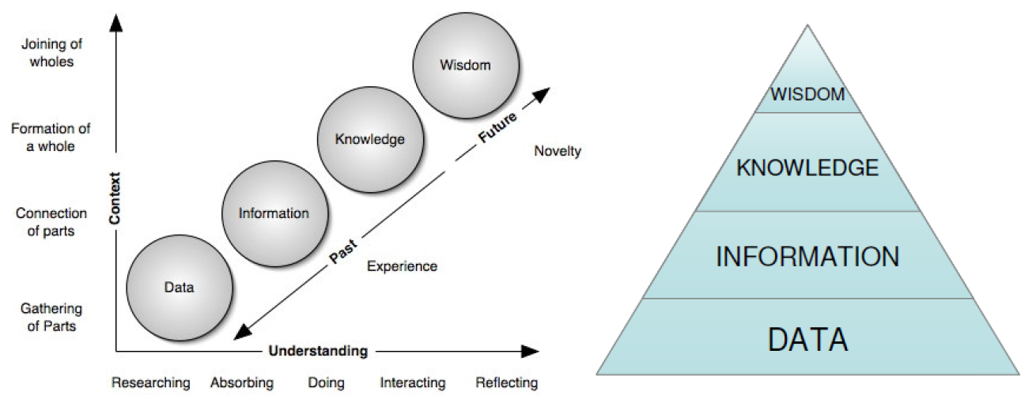
From Data to Wisdom – Visualizing Knowledge Change
Mapping and Visualizing Change
Progressing to Wisdom
(Clark, 2010)
Winnowing to Wisdom
(Hey, 2004)
Source: Flood, Lemieux, Varga & Wong. 2014. “The Application of Visual Analytics to Financial Stability Monitoring.” Office of Financial Research, Working Paper.

Slide 10
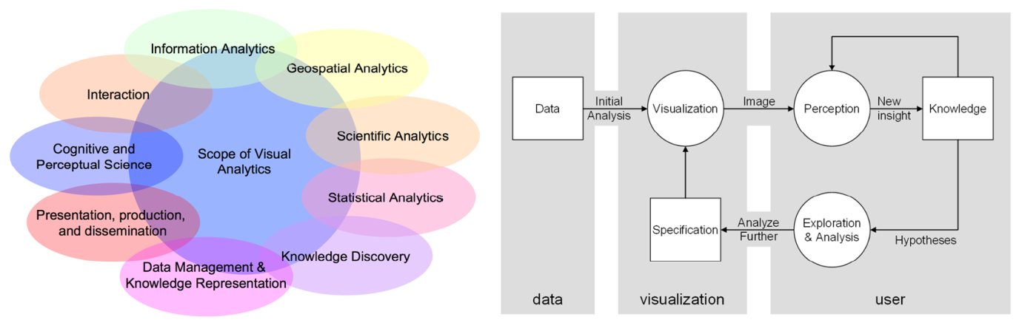
Visualizing and Mapping Human Interaction in Multi-disciplinary Manner
Multidisciplinary
(Keim, et al., 2006)
Human-in-the-Loop Analysis
(adapted from van Wijk, 2005)
Source: Flood, Lemieux, Varga & Wong. 2014. “The Application of Visual Analytics to Financial Stability Monitoring.” Office of Financial Research, Working Paper.

Slide 11
Section 1
Meta-economics
All sciences are narratives defined in their own technical language
Our paradigm (way of thinking) shapes our perception of reality

Slide 12
Complexity Economics Shows Us the Unseen Side of the Moon – Brian Arthur (2014)
Complexity economics – attempt to integrate silos of different specialized fields of science, social science and human arts into realm of system-wide thinking – system change unfolds through different algorithms of thought and behavior
Economy is complex – Elements reacting to patterns these elements together create
Complexity economics asks: How will agents react next and the pattern further unfold?
Standard economics asks: What agents’ behavior is in equilibrium with the pattern it creates? – Restrictive. Can only pick up timeless phenomena
Complexity economics: History matters. Economy forming, and re-forming
Source: Arthur. 2014. “Complexity and the Economy.” Oxford University Press.

Slide 13
Soros Theory of Reflexivity
There is complex non-linear and inter-active relationship between thinking and reality
Principle of Fallibility – our view of the world is always partial and distorted. By abstracting data into higher integrative and reductionist principles or patterns, lens or map that we use to diagnose our environment and make decisions are by definition reductionist
Two elements to reflexive behavior – cognitive function and manipulative function
Cognitive function seeks to understand the environment
Manipulative function acts to change it – decision and action
Reflexive inter-action changes context in dynamic, non-linear ways, because all market participants are inter-connected
Source: Soros. 2014. “Fallibility, Reflexivity, and the Human Uncertainty Principle.” Journal of Economic Methodology.

Slide 14
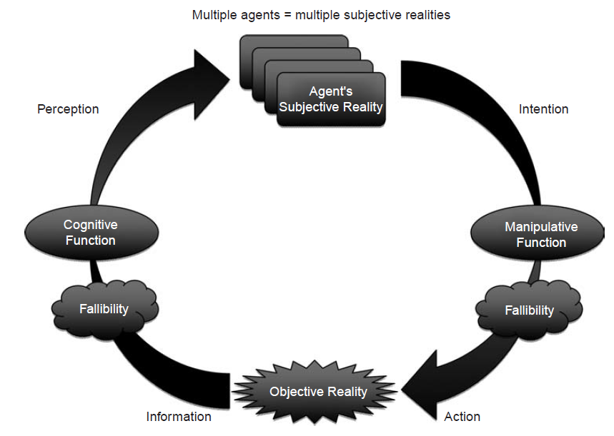
Soros – Reflexive Systems – thinking changes reality that changes cognition that changes action that changes context
Source: Soros. 2014. “Fallibility, Reflexivity, and the Human Uncertainty Principle.” Journal of Economic Methodology.

Slide 15
Radical Uncertainty and Model Risk
– Lo and Mueller (2010)
Frank Knight – Risk (Measurable probabilities) and Uncertainty (non-measurable)
Taxonomy of Uncertainty:
Level 1: Complete Certainty – Physical laws
Level 2: Risk without Uncertainty – Measurable risk
Level 3: Fully Reducible Uncertainty – Big Data computable with more granular data
Level 4: Partially Reducible Uncertainty – Known Unknowns
Level 5: Irreducible Uncertainty – Unknown Unknown
All models are defective because of they cannot compute Level 4 and Level 5 uncertainties – hence, judgement is needed to interpret model outputs

Slide 16
From Normal Distributions to Power Law Fat Tails
– Nassim Taleb Anti-fragility (2012)
Golden Mean
“Bad” Black Swan – uncertain but high impact
“Good” Black Swan
– low cost, high return options
95%
2.5%
2.5%
Tail Risks

Slide 17
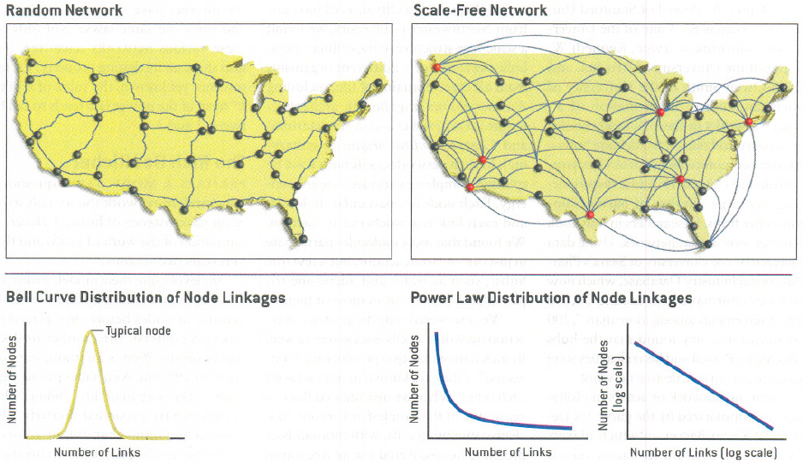
Networks Exhibit Power Law Patterns
Source: Barabasi & Bonabeau. 2003. “Scale-Free Networks.” Scientific American.

Slide 18
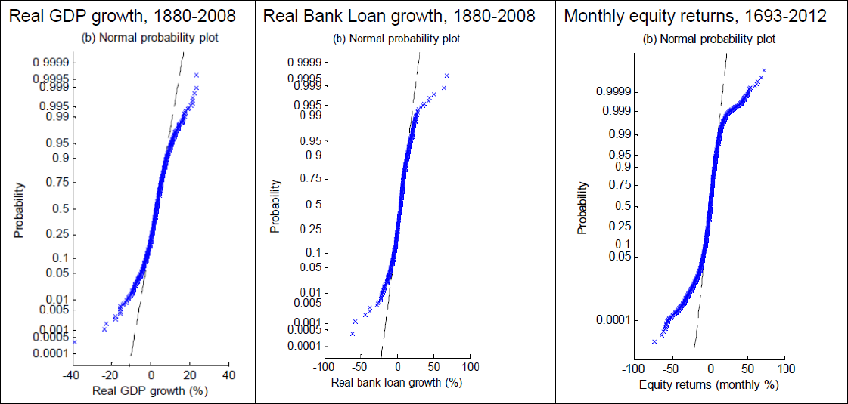
Long Run Markets Behave Less on Normal Distribution and More Power Law Distributions
Source: Haldane. 2015. “On Microscopes and Telescopes.” Bank of England.

Slide 19
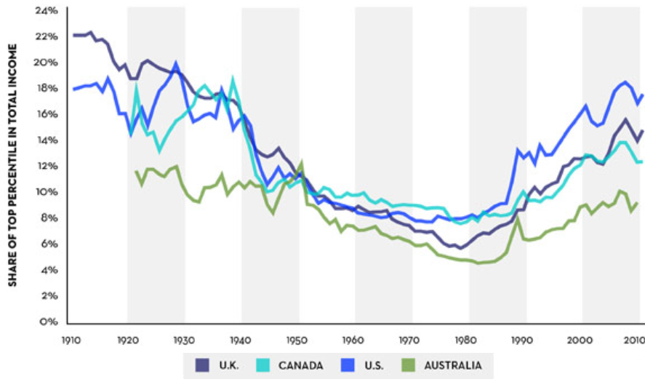
Income Inequality in Anglo-Saxon Countries, 1910-2010
Source: Cassidy. 2014. ”Piketty’s Inequality Story in Six Charts.” New Yorker.

Slide 20
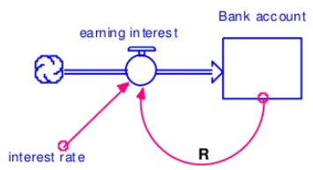
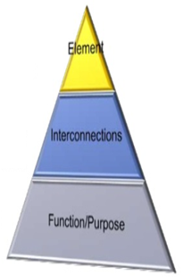
Thinking in Systems – Donella Meadows (2012)
What is a System?
Feedback Loops
“A system is an interconnected set of elements that is coherently organized in a way that achieves something (function or purpose).”
A feedback loop occurs when a stock affects its flows
Least effect on system
A feedback loop is formed when changes in stock affect the flows into or out of that same stock
Feedback loops can cause stocks to maintain their level within a range or grow or decline. The stock level feeds back through a chain of signals and actions to control itself
Greatly alters system
Most crucial determinant of a system’s behavior
Source: Meadows. 2012. “Thinking in Systems.”

Slide 21
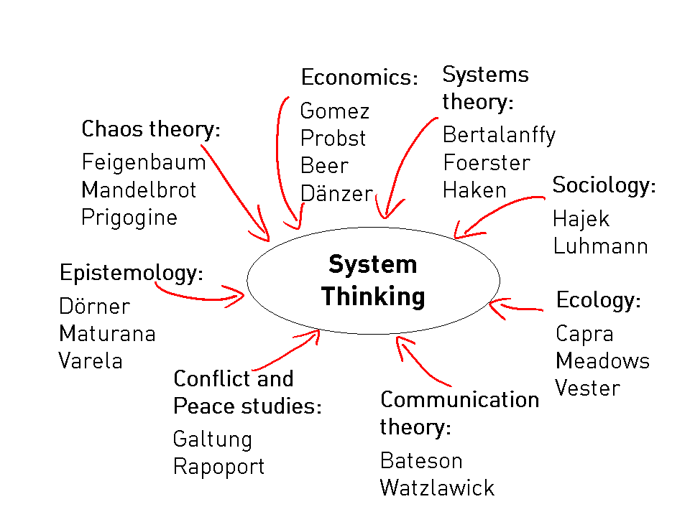
System Thinking Generates New Theories in Various Fields

Slide 22
Section 2
Mezo-economics
Architecture of Markets and Institutions
All institutions have hierarchy – hierarchy determines distribution and inequality in system

Slide 23
All Systems Have Architecture
All complex systems are networks which exchange information, resources and energy across links and nodes
These networks have architecture, and therefore hierarchy
Financial systems are networks of payment or exchanges of property rights – they are inherently hierarchical
Such hierarchy means that inequality is inherent in system

Slide 24
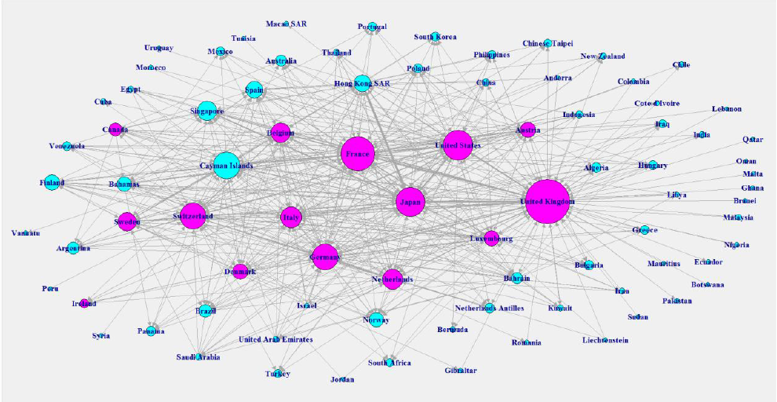

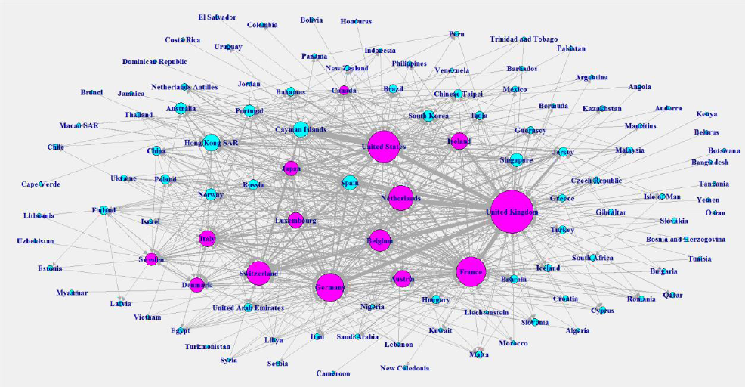
Global Banking System More Tightly
Inter-connected (1990-2007)
1990
2007
Source: Haldane. 2015. “On Microscopes and Telescopes.” Bank of England.

Slide 25
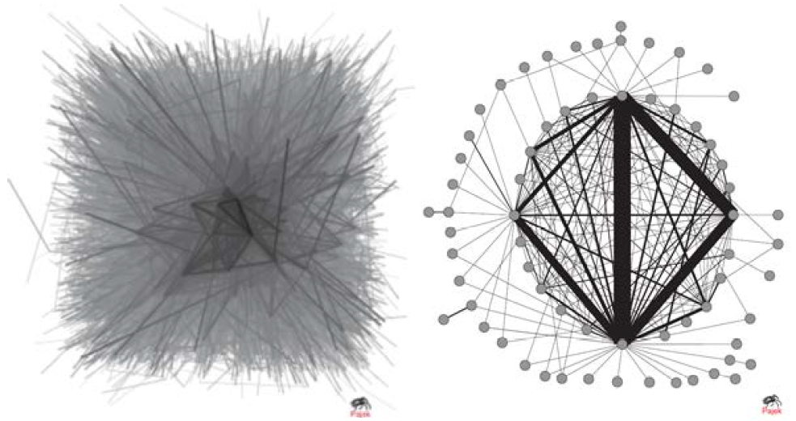
Topology of Financial Networks
The Complete Fedwire Network
(Soramäki, et al., 2007)
Filtering the Top 75 Percent of the Network (Soramäki, et al., 2007)
Source: Flood, Lemieux, Varga & Wong. 2014. “The Application of Visual Analytics to Financial Stability Monitoring.” Office of Financial Research, Working Paper.

Slide 26
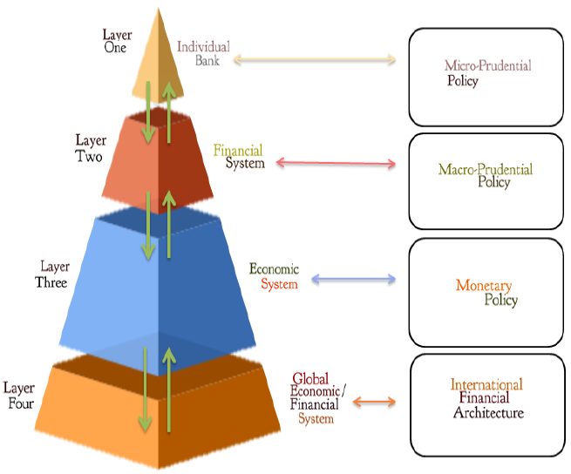
Macro-Financial System of Systems
Source: Haldane. 2015. “On Microscopes and Telescopes.” Bank of England.

Slide 27
Hierarchical Nature of Standards, Codes, Rules, Administrative Law, Legislative Law
Legislative Law
Administrative law
Mutual rules, e.g. Stock Exchange or Banker Association rules
Due Process and Bureaucratic practice
Standards – definition,
e.g. LEI
Highest law, but subject to interpretation, not enforceable abroad
Can be arbitrary and conflicting due to implementation by different agencies
If basic contract of rights not stable, financial derivatives unstable
Private rules, e.g. ISDA Contract

Slide 28
Legal Theory of Finance
– Katherina Pistor, Columbia Law School (2013)
Finance is legally constructed, defined by law and administrative enforcement
Two basic premises – fundamental uncertainty and liquidity volatility. Contradiction between Finance operating in uncertainty, but law tries to define certainty (hence increasing complexity)
Law and finance locked in a dynamic process in which rules that establish the game are continuously being “gamed” by new contractual devices (financial innovation) based on regulatory arbitrage, which in turn seek legal vindication or reform

Slide 29
How Simple Principles Determine Macro-outcomes: Risk Shift vs Risk Share
Debt is rising to unsustainable levels (286% of global GDP) – MGI estimates
Debt shifts burden of loss to borrower from lender – usurious when real interest rates are high
Equity (Islamic finance) is about risk-sharing – the investor and investee share risks – this is sustainable finance
Risk shift (debt) is unjust and unsustainable. Risk sharing is more systemic in approach and therefore sustainable. We are on one planet and share the same risks and uncertainty

Slide 30
Section 3
Macro-economics
A question of social choice
An Illustration of how Inequality, Ecology and Finance can be inter-related

Slide 31
Political Economy of Social Choice
Ultimately, political economy is about social choice theory
Under conditions of uncertainty, what forms of social governance determines “best” outcome?
Free market ideology thinks that there is best solution
But in complex, time, context and reflexive change, Because time, no “best” target or path to target for all time
Arrow Impossibility Theorem suggests that rational democratic voting may not lead to determinate outcome
In other words, there are many roads to Rome

Slide 32
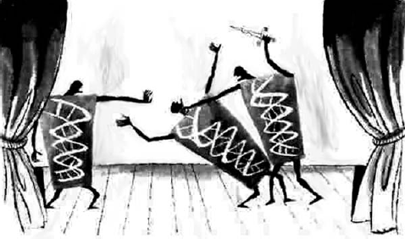
Do Individual Decisions Add Up to Same Group Decisions: Lessons from Physics
Conclusions
Collective phenomena and emergence characterize systems, from microbial communities to the biosphere
A fundamental challenge is to scale from microscopic to macroscopic, to allow a “crude look at the whole”
Conflict and cooperation are challenges in all systems
Mathematics and physics can inform and be inspired
www.flatrock.org.nz
Source: Simon Levin. 2013. “Collective Phenomenon, Collective Motion and Collection Action in Ecological Systems.”

Slide 33
Econophysics Model of Inter-relationship between Money, Inequality and Stability
General Equilibrium models rarely tie up relationship between money, real economy, distribution and sustainability (fixed constraints)
Although real goods can be created, there is fixed limit in natural resources
Money and debt can be created almost without limit, unless hard budget constraints are put in
Yakovenko and others (2003), noticed parallel between money distribution and energy distribution patterns in physics (Boltzmann-Gibbs Distribution)
Without hard budget constraints, debt and monetary creation by central banks create unstable systems (see simulation)

Slide 34
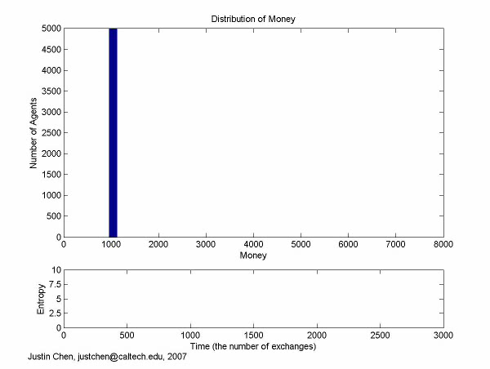
Yakovenko Model of Money Exchange (2007)
Source: Yakovenko. 2007. “Computer Animation of Money Exchange Models.” video file animation-1.avi, 1.4 MB.

Slide 35
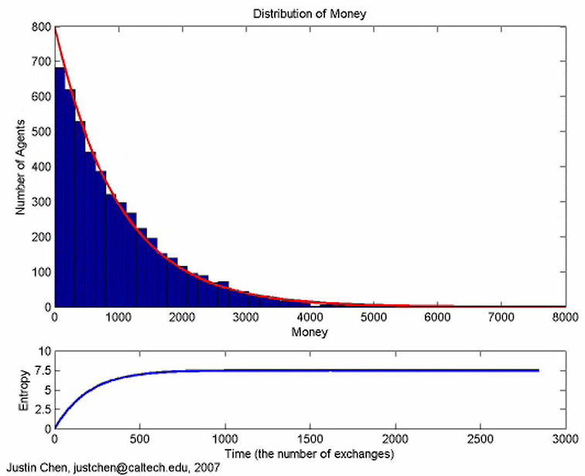
Simulation Model Shows that Expanded Monetary Distribution is Unstable
Source: Yakovenko. 2007. “Computer Animation of Money Exchange Models.”

Slide 36
Section 4
Implications for Development Policy

Slide 37
Economic Evolution is result of Three Interlinked Processes – Eric Beinhocker (2005)
PT – Physical Technology
ST – Social Technology
BD – Business Design. A process of differentiation, selection and amplification, with market as final arbiter of fitness
  Three-way co-evolution of PT, ST and BD accounts for the patterns of change and growth in the economy
Systemic Statecraft requires understanding that Business Plans game State policies and regulations – unless incentives are changed towards appropriate direction

Slide 38
Smart Statecraft Shapes Outcome of Qualitative Growth
Business models
Market competition
Technology
Consumption lifestyle
Economic Performance
Non-renewable resource consumption
Carbon footprint
Pollution & waste
Packaging
Sustainability
Environmental Performance
Social Performance
Policy framework
Taxation
Regulatory enforcement
Fiscal sustainability
National interests
Collective action trap:
Who funds Global Public Goods?

Slide 39
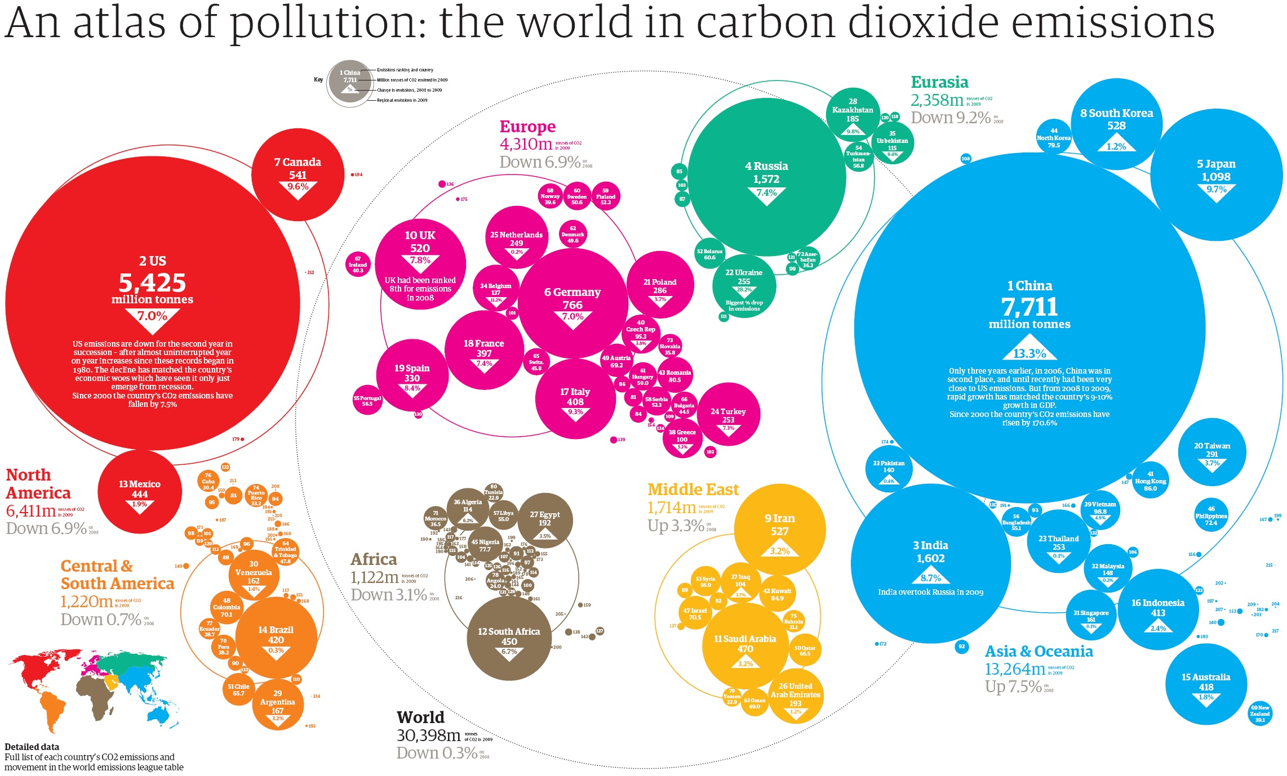
  Source: International Energy Statistics. 2011.

Slide 40
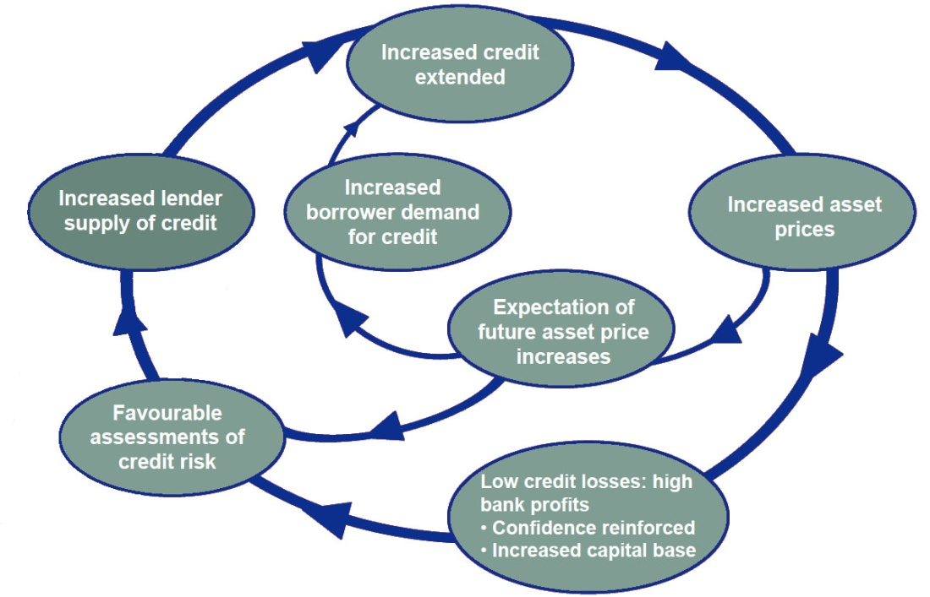

Financial Market Systemic Risks Originate from Interactions Among Domestic and Global Participants
Price Upswing
Price Downswing
Source: UK Financial Services Authority.
Each Asian economy needs a well-functioning ecosystem of finance to manage the systemic risks. Otherwise, it will face volatile asset bubbles and exaggerated price cycles, funded by hot capital inflows

Slide 41
Finance: Engine of Growth or Bubble?
Engine of Growth
Engine of Bubble
Growth
Jobs
Value
Distribution
-
+
Finance Ecosystem
Money & Macro
Regulation
External
Financial Structure
Others

Slide 42
Sustainable Relations
Current international economic relations are unsustainable because of national and global Collective Action Traps (note failed negotiations)
Competition needs to be a “race to the top” for environmental sustainability, social equity, and globally beneficial outcomes
How do you avoid the “clash”?
    By definition, sustainability is a supranational objective
    In PPP, put People and Planet before Profits – Profits will come when there is Equality and Environment is Sustainable

Slide 43
How to Deal with Systems Reform?
– Donella Meadows, Thinking in Systems, Primer (2008)
A system is more than the sum of its parts. It exhibits adaptive, dynamic, goal-seeking, self-preserving, and sometimes evolutionary behavior
No physical entity can grow forever. If company managers, city governments, and the human population do not choose and enforce their own limits to keep growth within the capacity of the supporting environment, then the environment will choose and enforce limits
The trap called the tragedy of the commons comes about when there is escalation, or just simple growth, in a commonly shared, erodible environment

Slide 44
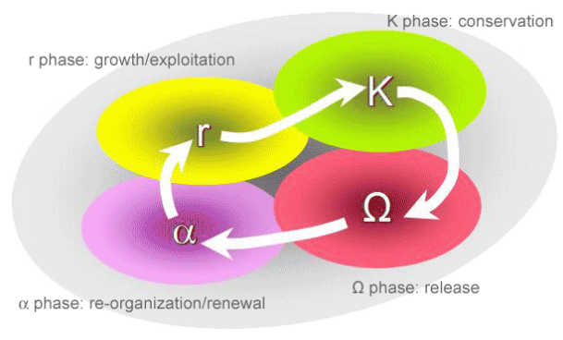
Ecological Systems Go through Adaptive Cycles of Growth and Renewal
  Source: Resilience Alliance. 2015. “Adaptive Cycle.”

Slide 45
“Governing The Commons: The Evolution of Institutions for Collective Action” – Elinor Ostrom (1990)
Historically, people can create institutions for collective action that benefits them all
Rules of the game can be changed to turn zero-sum games into non-zero-sum games
Successful basic design principles:
  Group boundaries are clearly defined
  Rules governing use of collective goods match local needs and conditions
  Legitimacy - individuals affected can participate in modifying the rules.
  Community Rights respected by external authorities
  Wiki-monitoring: community themselves monitoring of member behavior.
  A graduated system of sanctions is used
  Access to low-cost conflict resolution mechanisms
  For larger systems: appropriation, provision, monitoring, enforcement, conflict resolution, and governance activities are organized in multiple layers of nested enterprises

Slide 46
Strategic Intervention in Complex Systems –
Finding “Leverage Points” (adapted from Ostrom/Meadows)
Foster shared values (community) and cultivate networks
Work at multiple levels of scale (top down, bottom up, outside in, and inside out) for legitimacy
Make space for self-organization
Create Diversity
Get Incentives right – promote competition (race to top)
Pay attention to what is important, not just what is quantifiable
Make Feedback policies for Feedback systems
Be prepared to make sacrifices for greater good (system unstable when even leader is free rider)
Assume that change is going to take time
Be prepared to be surprised

Slide 47
The Next Catastrophe – Charles Perrow, (2011 ed.) Reducing Our Vulnerabilities to Natural, Industrial, and Terrorist Disasters
Accidents often result of unanticipated multiple failures in a complex system, generated by extreme complexity and tight coupling, where additional safety regimes which added to the complexity might increase the probability of system failure
Perrow suggests that our best hope lies in the deconcentration of high-risk populations, corporate power, and critical infrastructures such as electric energy, computer systems, and the chemical and food industries

Slide 48
Food for Thought
Perhaps the greatest challenge for Asia is to “rediscover” how we can live in a Sustainable world, given rising population and the limits to Natural Resources
Since neo-classical economics failed to deal with the contradiction between limits to growth and material consumption, we must re-examine within ourselves the foundations of political economy – how can the world can be a better place, without limitless wants to unlimited self-destruction?
This is truly the challenge for Asian and global thinkers

Slide 49
THANK YOU
Andrew Sheng
as@andrewsheng.net

